Slide 1
The Smart Web
How AI is Revolutionizing Front-End Development

Slide 2
Introduction
This presentation explores how artificial intelligence is transforming front-end development, creating dynamic web experiences that are personalized and efficient.

Slide 3
01
AI in Front-End

Slide 4
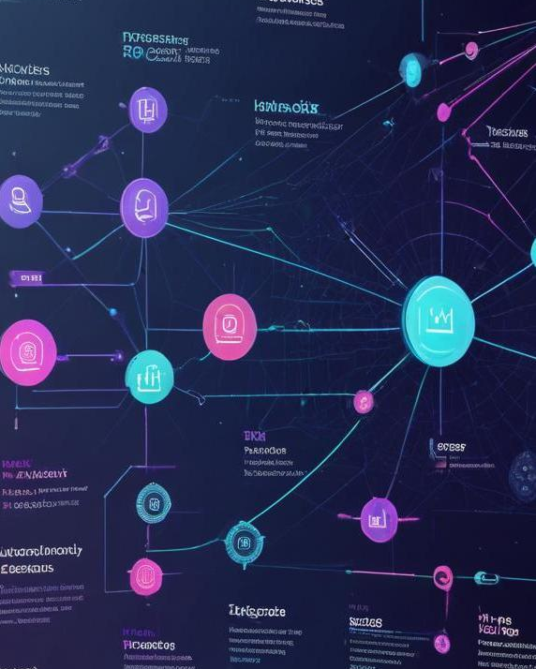
Evolution from static to AI-enhanced designs
The evolution of web design has progressed from simple, static pages to complex, AI-driven interfaces that adapt to user behavior. AI algorithms allow websites to analyze user interactions in real-time, optimizing content and layout for enhanced user engagement.

Slide 5
Importance of AI integration
Integrating AI into front-end development is crucial for creating user-centric applications. AI facilitates improved usability through personalization, accessibility features, and automated design processes, enhancing overall user experience and satisfaction.

Slide 6
Key milestones in AI and web development
The integration of AI into web development has seen several key milestones, such as the introduction of early machine learning algorithms for data analysis, the evolution of recommendation systems, and the adoption of natural language processing for improved user interfaces. Notable advancements include the emergence of AI-driven design tools, automated testing systems, and intelligent analytics platforms that revolutionize how developers approach project design and execution.

Slide 7
02
AI-Powered UI/UX

Slide 8
Personalized content & smart recommendations
AI enhances user experience by providing personalized content based on user behavior, preferences, and interactions. Smart recommendation systems analyze past actions to suggest products, articles, or services that match user interests, thereby increasing engagement and satisfaction. This real-time adaptability helps create unique user journeys that can lead to higher conversion rates.

Slide 9
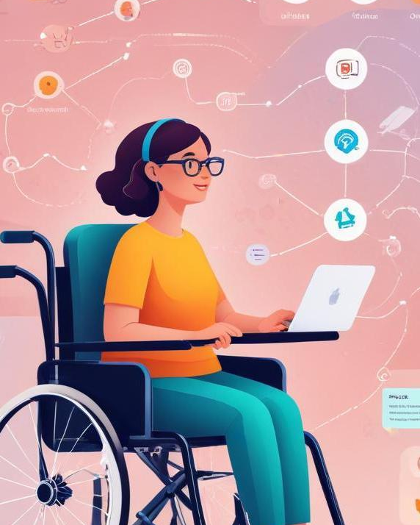
Accessibility improvements
AI significantly improves web accessibility by automating the creation of alt text for images, offering voice navigation options, and enabling real-time translation features. These advancements ensure that all users, including those with disabilities, can access and navigate websites effectively, fostering inclusivity and broader reach.

Slide 10
AI-based design tools
Modern design tools like Figma AI and Adobe Sensei leverage AI to assist designers in creating visually appealing and functional interfaces. These tools provide insights on design trends, automate repetitive tasks, and suggest enhancements based on user data, allowing designers to focus more on creativity and innovation.

Slide 11

Conclusions
The integration of AI into front-end development represents a significant shift towards smarter, user-centric web environments. As AI technology continues to evolve, it holds the potential to further revolutionize how we design, develop, and interact with web applications.

Slide 12

Thank you!
Do you have any questions?
+91 620 421 838

